Slide 1

Online Encounter 18
Notes:
ENCOUNTER 18
REVIEW STUDENT PROGRESS
Check for last Encounter attendance.
Check for last Speaking Center attendance and time spent.
Check that Lesson 3 has been completed.
Prepare general comments on Student attendance, study habits, and overall progress.
VIDEO SUMMARY
Shen is feeling nervous about his acting classes, so Benny advises him to dress like a famous actor so that he can feel more confident. Shen goes to his first class and makes a good impression on the teacher.
At the restaurant, Sofi asks Danielle for her opinions on some new dishes she has made. They gossip about Nadi and discuss why they do not like her.
Khae, Marco, and Aanya are trying to brainstorm ideas for their business projects, but they are not having much luck. They decide to take a break, but they cannot agree on what to do. In the end, they stay at Khae's apartment and watch a movie.
VOCABULARY OBJECTIVES
Can name a few common sports and hobbies (exercise; golf; museum; play; basketball; cricket; cycling; park; pool, run; swimming; tennis; walk)
Can use some basic language related to expressing an opinion (awesome; bad; boring, cool; favorite; funny; great; nice; old; sure; ugly; weird)
GRAMMAR OBJECTIVES
Can express very basic contrast using but (I like TV shows, but Marco likes movies.)
Can name a limited number of activities with do, go and play (We can play football.)
Can express very basic likes and dislikes with like/love/hate + -ing (I love going to museums.)
SPEAKING OBJECTIVES
Can express likes and dislikes about things they have or do in a very limited way (I like cheese.)
Can describe a person's likes and dislikes using simple language (She doesn’t like it.)

Slide 2

Encounter 18
Introductions
Your teacher
My name is .
Now please introduce yourself.
Notes:
INSTRUCTIONS
This is a warm-up activity and should not be assessed.
Introduce yourself to the Students. Then ask each individual Student what his/her name is. Tell the Students:
Hello. My name’s _______. What’s your name?
Sample Responses: My name’s _______./My name is _______.
TEACHING TIPS
Ask the Students about their study habits. (e.g., Have you finished your Speaking Center Lessons? How about your Student Manual or Digital Book?)
Check for IT issues.

Slide 3

Part 1.0: Warm-Up
do be can
Chinese food?
Do you like
married?
Are you
Ask me questions with these words.
swim?
Can you
Notes:
1.1 Do, Can, Be (10 min)
Allow two minutes for this slide.
OBJECTIVE
To help the Students relax and start thinking in English
INSTRUCTIONS
#1. Draw the Students’ attention to the cues at the top of the screen. [do, be, can]
#2. Have a Student read the request. [Ask me questions with these words.]
#3. Encourage a Student to make a question with “do” and “Chinese food.”
#4. Reveal a possible answer. [Do you like Chinese food?]
#5. Encourage a Student to make a question with “be” + “married.”
#6. Reveal a possible answer. [Are you married?]
#7. Encourage a Student to make a question with “can” + “swim.”
#8. Reveal a possible answer. [Can you swim?]

Slide 4
Part 1.0: Warm-Up
?
do be can
?
?
?
?
?
Notes:
1.1 Do, Can, Be
Allow eight minutes for this slide.
INSTRUCTIONS
Tell the Students, “Ask a classmate three questions: one question with ‘do,’ one question with ’can,’ and one question with ‘be.’ Answer your classmate’s questions.”
Allow one minute for the Students to talk to their classmates. Then, say to the Students, “Introduce your classmate to us.”
The Students take turns to introduce their classmates and say what they found out, for example,
This is Maggie. She likes watching TV. She can't speak Japanese. She's very happy today!

Slide 5

Part 2.0: Target Language
Activity 2.1: Context Creation
What are some sports and hobbies you know?
Sing.
Dance.
Go to museums.
Notes:
2.1 Sports and Hobbies Vocabulary Race (5 min)
Allow one minute for this slide.
OBJECTIVE
Can name a few common sports and hobbies (exercise; golf; museum; play; basketball; cricket; cycling; park; pool, run; swimming; tennis; walk)
INSTRUCTIONS
#1. Have a Student read the question. [What are some sports and hobbies you know?]
#2. Encourage each Student to answer.
#3. Reveal the sample answers. [Dance./Sing./Go to museums.]
TEACHING TIPS
Elicit a variety of the target vocabulary.
Elicit from each Student.
It helps to board elicited language.

Slide 6
Part 2.0: Target Language
Activity 2.1: Context Creation
What are some other sports and hobbies you know?
golf
tennis
reading
Notes:
2.1 Sports and Hobbies Vocabulary Race
Allow one minute for this slide.
INSTRUCTIONS
#1. Have a Student read the question. [What are some other sports and hobbies you know?]
#2. Encourage each Student to answer.
#3. Reveal the sample answers. [golf, reading, tennis]
TEACHING TIPS
Elicit a variety of the target vocabulary.
Elicit from each Student.
It helps to board elicited language.

Slide 7
Part 2.0: Target Language
Activity 2.1: Concept Check
.
No. It’s not a sport or hobby
Why not?
Is cleaning a sport
or hobby?
.
It’s not fun
Notes:
2.1 Sports and Hobbies Vocabulary Race
Allow one minute for this slide.
INSTRUCTIONS
#1. Concept check by having a Student read the question. [Is cleaning a sport or hobby?]
#2. Encourage the Students to answer.
#3. Reveal the sample answer. [No. It’s not a sport or hobby.]
#4. Have a Student read the question. [Why not?]
#5. Encourage the Students to answer.
#6. Reveal the sample answer. [It’s not fun.]
TEACHING TIPS
The Students don’t need to specifically say “cleaning isn’t fun,” but they should convince you that they have a general understanding of what separates sports and hobbies from other types of activities.
Elicit target language from each Student.

Slide 8





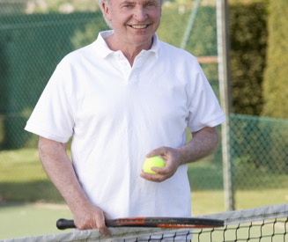

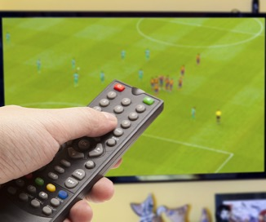
Part 2.0: Target Language
Activity 2.1: Practice
Vocabulary Race
A
B
C
D
E
F
G
H
Notes:
2.1 Sports and Hobbies Vocabulary Race
Allow two minutes for this slide.
INSTRUCTIONS
Tell the Students, “I am going to show some pictures. The Student who says the name of the sport or hobby first and spells the word, gets a point.”
#1. Reveal A. (dancing)
#2. Reveal B. (golf)
#3. Reveal C. (reading)
#4. Reveal D. (listening to music)
#5. Reveal E. (art/going to museums)
#6. Reveal F. (tennis)
#7. Reveal G. (singing)
#8. Reveal H. (watching TV)
TEACHING TIP
If a word is spelled wrong, do not award a point.

Slide 9
Part 2.0: Target Language
Activity 2.1: Extension
A
B
C
D
E
F
G
H
Notes:
2.1 Sports and Hobbies Vocabulary Race
Optional Extension
INSTRUCTIONS
Have the Students talk with their classmates to see who has done each of these activities. Encourage the Students to elaborate on the experiences they have had with these activities. If someone has not done a particular activity ask if it is something they would like to try in the future.
Afterwards, have the Students tell you what they learned about their classmates.

Slide 10
Part 2.0: Target Language
Activity 2.1: Feedback
Student 1
Student 2
Student 3
Student 4
Great job!
Great job!
Great job!
Great job!
Well done
Well done
Well done
Well done
Good try
Good try
Good try
Good try
More practice
More practice
More practice
More practice
Feedback
Notes:
2.1 Sports and Hobbies Vocabulary Race
FEEDBACK
Quickly give the Students feedback on the target language they just practiced.
Remind them of other resources they can take advantage of to improve their English:
Go to Wall Street World to practice grammar and vocabulary.
Review the Student Manual or Digital Book to study grammar and vocabulary.
Attend Complementary Classes to practice using grammar and vocabulary.
Join Social Clubs to practice speaking skills.

Slide 11

Part 2.0: Target Language
Activity 2.2: Context Creation
No, .
?
like?
I don’t like golf
Do you like playing golf
Why or why not?
.
Yes, .
It’s boring
I like golf
.
It’s my favorite sport
Notes:
2.2 Expressing Opinions (5 min)
Allow one minute for this slide.
OBJECTIVES
Can use some basic language related to expressing an opinion (awesome; bad; boring, cool; favorite; funny; great; nice; old; sure; ugly; weird)
Can express very basic contrast using but (I like TV shows, but Marco likes movies.)
INSTRUCTIONS
#1. Draw the Students’ attention to the cue at the top of the screen and the image of the golfer.
#2. Elicit the corresponding question.
#3. Reveal the question. [Do you like playing golf?] (Also accept “Do you like golf?”)
#4. Encourage the Students to read the text and fill in the missing words to complete the response.
#5. Reveal the answer. [Yes, I like golf.]
#6. Encourage the Students to read the text and fill in the missing words to complete the response.
#7. Reveal the answer. [No, I don’t like golf.]
#8. Have a Student read the question. [Why or why not?]
#9. Encourage the Students to answer.
#10. Reveal the sample answers. [It’s my favorite sport./It’s boring.]]
TEACHING TIPS
If you have a weaker group, spend more time at this stage, and elicit more target language phrases for giving opinions.
Elicit a variety of the target vocabulary.
Elicit from each Student.
It helps to board elicited language.

Slide 12

Part 2.0: Target Language
Activity 2.2: Context Creation
because
I like golf it’s fun.
Notes:
2.2 Expressing Opinions
Allow one minute for this slide.
INSTRUCTIONS
#1. Draw the Students’ attention to the gapped sentence at the top of the screen. Encourage the Students to link both phrases together with “because.” [I like golf _____ it’s fun.]
#2. Reveal the answer. [I like golf because it’s fun.]
TEACHING TIPS
Elicit a variety of the target vocabulary.
Elicit from each Student.
It helps to board elicited language.

Slide 13
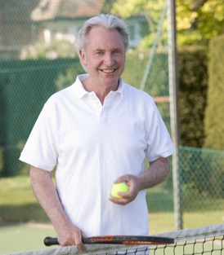

Part 2.0: Target Language
Activity 2.2: Context Creation
.
I like golf, but I don’t like tennis
I like golf. I don’t like tennis.
Can you put these two sentences together?
Notes:
2.2 Expressing Opinions
Allow one minute for this slide.
INSTRUCTIONS
#1. Have a Student read the statement and question. [I like golf. I don’t like tennis. Can you put these two sentences together?]
#2. Encourage the Students to combine the two statements into one.
#3. Reveal the answer. [I like golf, but I don’t like tennis.]
TEACHING TIPS
Elicit a variety of the target vocabulary.
Elicit from each Student.
It helps to board elicited language.

Slide 14

Part 2.0: Target Language
Activity 2.2: Concept Check
.
.
I like shopping
I like shopping, but I don’t have any money
How can I finish this? I like shopping, but…
Let’s say you like shopping. How can you say that?
Notes:
2.2 Expressing Opinions
Allow one minute for this slide.
INSTRUCTIONS
#1. Concept check by having a Student read the statement and question. [Let’s say you like shopping. How can you say that?]
#2. Encourage the Students to answer.
#3. Reveal the sample answer. [I like shopping.]
#4. Have a Student read the question and partial statement. [How can I finish this? I like shopping, but…]
#5. Encourage the Students to answer.
#6. Reveal the sample answer. [I like shopping, but I don’t have any money.]
TEACHING TIP
Elicit target language from each Student.

Slide 15

Part 2.0: Target Language
Activity 2.2: Practice
movies or museums?
acting or singing?
playing golf or tennis?
watching TV or dancing?
playing football or swimming?
reading or running?
playing or studying?
playing football or basketball?
Notes:
2.2 Expressing Opinions
Allow one minute for this slide.
INSTRUCTIONS
The Students take turns giving their opinions of the activities they see listed on the screen. Have the Students also provide the reason why they either like or don’t like something. For example,
A: Do you like movies or museums?
B: I love movies, but I don’t like museums.
A: Why do you like movies?
B: They’re really fun.
TEACHING TIP
Make sure the Students use full sentences.

Slide 16
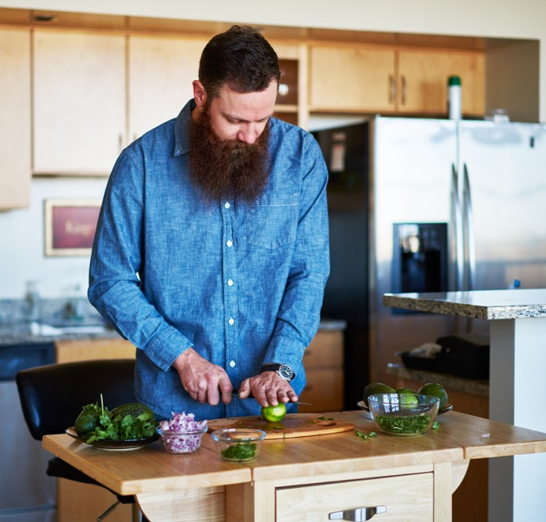
Part 2.0: Target Language
Activity 2.2: Extension
.
.
Notes:
2.2 Expressing Opinions
Optional Extension
INSTRUCTIONS
Encourage each Student to come up with three different activities that were not discussed throughout this activity (help the Students brainstorm activities if necessary). Then ask each Student to make at least one sentence expressing his/her opinion about each activity.
Invite the Students to share their answers with the class.
TEACHING TIPS
Elicit from each Student.
It helps to board elicited language.

Slide 17
Part 2.0: Target Language
Activity 2.2: Feedback
Student 1
Student 2
Student 3
Student 4
Great job!
Great job!
Great job!
Great job!
Well done
Well done
Well done
Well done
Good try
Good try
Good try
Good try
More practice
More practice
More practice
More practice
Feedback
Notes:
2.2 Expressing Opinions
FEEDBACK
Quickly give the Students feedback on the target language they just practiced.
Remind them of other resources they can take advantage of to improve their English:
Go to Wall Street World to practice grammar and vocabulary.
Review the Student Manual or Digital Book to study grammar and vocabulary.
Attend Complementary Classes to practice using grammar and vocabulary.
Join Social Clubs to practice speaking skills.

Slide 18
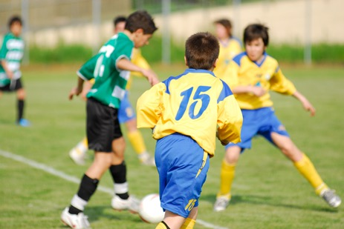

Part 3.0: Target Structures
Activity 3.1: Context Creation
What are they doing?
What is he doing?
.
They’re playing football
.
He’s doing homework
Notes:
3.1 Do-Play-Go Quiz (5 min)
Allow one minute for this slide.
OBJECTIVE
Can name a limited number of activities with do, go and play (We can play football.)
INSTRUCTIONS
#1. Draw the Students’ attention to the picture.
#2. Have a Student read the question. [What are they doing?]
#3. Encourage the Students to answer.
#4. Reveal the sample answer. Also accept “They’re playing soccer.” [They're playing football.]
#5. Draw the Students’ attention to the picture.
#6. Have a Student read the question. [What is he doing?]
#7. Encourage the Students to answer.
#8. Reveal the answer. [He’s doing homework.]
TEACHING TIPS
Elicit examples of the target structure(s).
Elicit from each Student.
It helps to board elicited language.

Slide 19
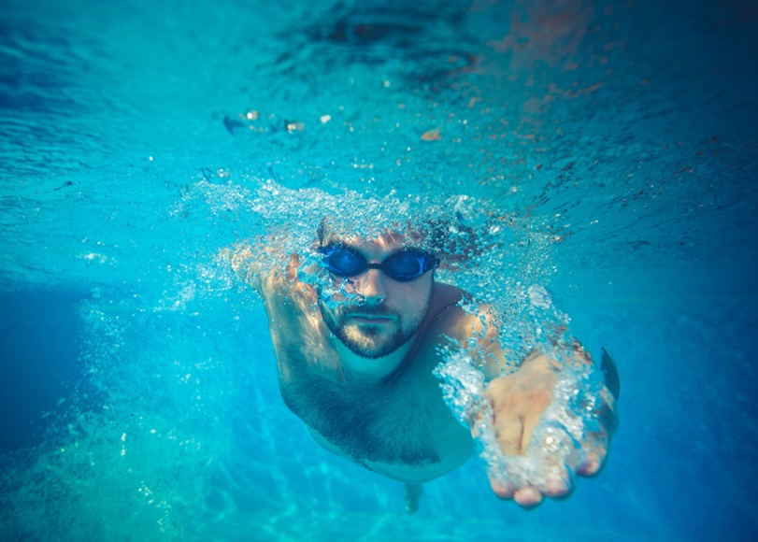
Part 3.0: Target Structures
Activity 3.1: Context Creation
What about swimming? Do you play swimming or do you go swimming?
play do go
.
You go swimming
Notes:
3.1 Do-Play-Go Quiz
Allow one minute for this slide.
INSTRUCTIONS
#1. Have a Student read the question. [What about swimming? Do you play swimming or do you go swimming?]
#2. Encourage the Students to answer.
#3. Reveal the answer. [You go swimming.]
#4. Draw the Students’ attention to the target words above the picture and have them read the words aloud.
TEACHING TIPS
Elicit examples of the target structure(s).
Elicit from each Student.
It helps to board elicited language.

Slide 20
Part 3.0: Target Structures
Activity 3.1: Concept Check
What are some other things we play, do, and go?
play do go
.
play basketball, do laundry, go shopping
Notes:
3.1 Do-Play-Go Quiz
Allow one minute for this slide.
INSTRUCTIONS
#1. Concept check by having a Student read the question. [What are some other things we play, do, and go?]
#2. Encourage the Students to answer.
#3. Reveal the sample answers. [play basketball, do laundry, go shopping]
TEACHING TIP
Elicit target language from each Student.

Slide 21


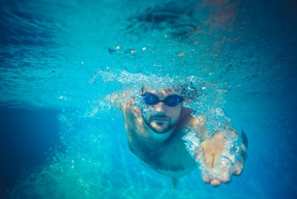
Part 3.0: Target Structures
Activity 3.1: Practice
play | do | go
tennis
homework
cycling
soccer
laundry
running
golf
something interesting
to the movies
tennis
homework
cycling
soccer
laundry
running
to the movies
golf
something interesting
Notes:
3.1 Do-Play-Go Quiz
Allow one minute for this slide.
INSTRUCTIONS
Draw the Students’ attention to the chart on the screen. Then have the Students say whether each verb collocates with “do,” “play,” or “go.” As the Students give the correct answer, reveal the verb in the chart.
#1-2. Have a Student read the word. [tennis]; reveal the answer. (play)
#3-4. Have a Student read the word. [homework]; reveal the answer. (do)
#5-6. Have a Student read the word. [cycling]; reveal the answer. (go)
#7-8. Have a Student read the word. [soccer]; reveal the answer. (play)
#9-10. Have a Student read the word. [laundry]; reveal the answer. (do)
#11-12. Have a Student read the word. [running]; reveal the answer. (go)
#13-14. Have a Student read the word. [to the movies]; reveal the answer. (go)
#15-16. Have a Student read the word. [golf]; reveal the answer. (play)
#17-18. Have a Student read the word. [something interesting]; reveal the answer. (do)

Slide 22

Part 3.0: Target Structures
Activity 3.1: Practice
Can you think of more things you can play, do, or go?
play | do | go
Notes:
3.1 Do-Play-Go Quiz
Allow one minute for this slide.
INSTRUCTIONS
#1. Have a Student read the question. [Can you think of more things you can play, do, or go?]
#2. Encourage the Students to answer. Aim to elicit at least one example from each Student, for example:
play football, go walking/running, do homework
TEACHING TIP
Do not accept collocations with “go” + a destination, for example “go home” or “go to London.” Elicit collocations that describe activities. “Go to the movies” would be acceptable, for example.

Slide 23



Part 3.0: Target Structures
Activity 3.1: Extension
play do go
tennis
homework
cycling
soccer
laundry
running
to the movies
golf
something interesting
Notes:
3.1 Do-Play-Go Quiz
Optional Extension
INSTRUCTIONS
Ask each Student to choose three of the activities on the screen and make at least one sentence with each word or phrase.
Invite the Students to share their sentences with the class.

Slide 24
Part 3.0: Target Structures
Activity 3.1: Feedback
Student 1
Student 2
Student 3
Student 4
Great job!
Great job!
Great job!
Great job!
Well done
Well done
Well done
Well done
Good try
Good try
Good try
Good try
More practice
More practice
More practice
More practice
Feedback
Notes:
3.1 Do-Play-Go Quiz
FEEDBACK
Quickly give the Students feedback on the target language they just practiced.
Remind them of other resources they can take advantage of to improve their English:
Go to Wall Street World to practice grammar and vocabulary.
Review the Student Manual or Digital Book to study grammar and vocabulary.
Attend Complementary Classes to practice using grammar and vocabulary.
Join Social Clubs to practice speaking skills.

Slide 25
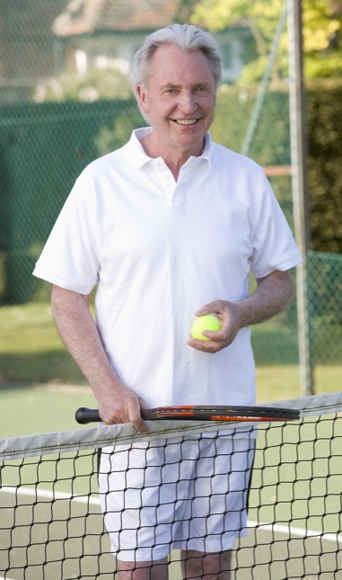
Part 3.0: Target Structures
Activity 3.2: Context Creation
What is he doing?
Is he happy?
Why?
.
.
He’s playing tennis
Yes, he is
.
Because he likes playing tennis
Notes:
3.2 Loves, Likes, Hates (10 min)
Allow one minute for this slide.
OBJECTIVE
Can express very basic likes and dislikes with like/love/hate + -ing (I love going to museums.)
INSTRUCTIONS
#1. Have a Student read the question. [What is he doing?]
#2. Encourage the Students to answer.
#3. Reveal the answer. [He’s playing tennis.]
#4. Have a Student read the question. [Is he happy?]
#5. Encourage the Students to answer.
#6. Reveal the answer. [Yes, he is.]
#7. Have a Student read the question. [Why?]
#8. Encourage the Students to answer.
#9. Reveal the answer. [Because he likes playing tennis.] Also accept “Because he loves playing tennis.”
TEACHING TIPS
Elicit examples of the target structure(s).
Elicit from each Student.
It helps to board elicited language.

Slide 26
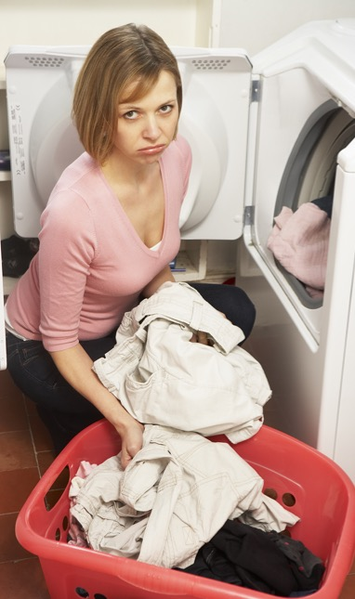
Part 3.0: Target Structures
Activity 3.2: Context Creation
What is she doing?
Is she happy?
Why?
.
.
She’s doing laundry
No, she’s not
.
Because she doesn’t like
doing laundry
Notes:
3.2 Loves, Likes, Hates
Allow one minute for this slide.
INSTRUCTIONS
#1. Have a Student read the question. [What is she doing?]
#2. Encourage the Students to answer.
#3. Reveal the answer. [She’s doing laundry.]
#4. Have a Student read the question. [Is she happy?]
#5. Encourage the Students to answer.
#6. Reveal the answer. [No, she’s not.]
#7. Have a Student read the question. [Why?]
#8. Encourage the Students to answer.
#9. Reveal the answer. [Because she doesn’t like doing laundry.] Also accept “Because she hates doing laundry.”
TEACHING TIPS
Elicit examples of the target structure(s).
Elicit from each Student.
It helps to board elicited language.

Slide 27
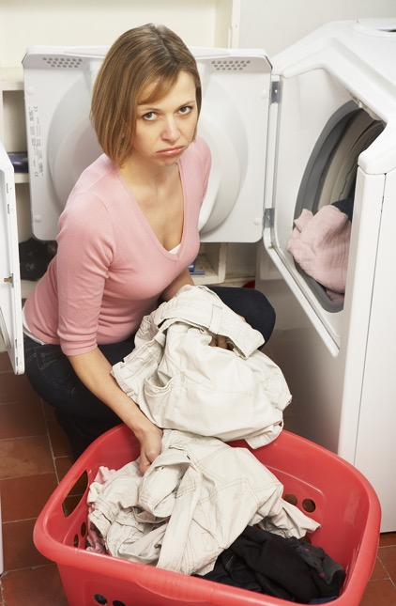
Part 3.0: Target Structures
Activity 3.2: Concept Check
Yes, .
like/laundry?
I like doing laundry
No, .
I don’t like doing laundry
Do you like doing laundry?
Notes:
3.2 Loves, Likes, Hates
Allow one minute for this slide.
INSTRUCTIONS
#1. Draw the Students’ attention to the cue words on the screen. [like/laundry?]
#2. Have a Student read the question. [Do you like doing laundry?]
#3. Encourage the Students to answer.
#4. Reveal the sample answers. [Yes, I like doing laundry./No, I don’t like doing laundry.]
TEACHING TIP
Elicit target language from each Student.

Slide 28
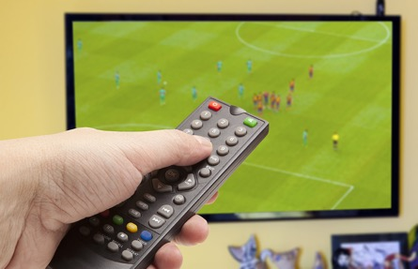

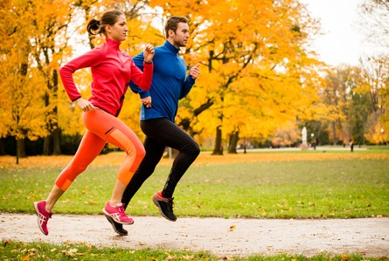


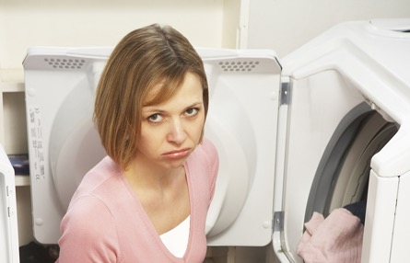
Part 3.0: Target Structures
Activity 3.2: Practice
Do/like?
Like love hate
A
B
C
D
E
F
Notes:
3.2 Loves, Likes, Hates
Allow four minutes for this slide.
INSTRUCTIONS
Tell the Students, “Use the pictures to ask your classmates what they like doing. Answer with a full sentence using ‘like,’ ‘love,’ or ‘hate.’ Give reasons to say why you like or don’t like something.”
Have the Students take turns asking questions with “Do you like …?” about each of the images and responding using “like,” “love,” or “hate.”
Allow two minutes for the Students to ask each other questions, and then say, “Tell me something you learned about your classmates.”
Elicit responses in open class. For example:
Kevin likes watching TV.
Natalia doesn't like dancing.
Allow one to two minutes for the open class review.
ANSWER KEY
A. watching TV
B. doing homework/studying
C. (going) running
D. (going) swimming
E. dancing
F. doing laundry

Slide 29

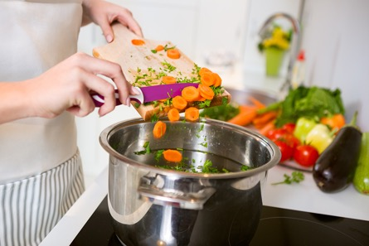




Part 3.0: Target Structures
Activity 3.2: Practice
Do/like?
Like love hate
A
B
C
D
E
F
Notes:
3.2 Loves, Likes, Hates
Allow three minutes for this slide.
INSTRUCTIONS
Tell the Students, “Use the pictures to ask your classmates what they like doing. Answer with a full sentence using ‘like,’ ‘love,’ or ‘hate.’ Give reasons to say why you like or don’t like something.”
Have the Students take turns asking questions with “Do you like …?” about each of the images and responding using “like,” “love,” or “hate.”
Allow two minutes for the Students to ask each other questions, and then say, “Tell me something you learned about your classmates.”
Elicit responses in open class. For example,
Ed likes reading.
Suri doesn't like going to museums.
Allow one to two minutes for the open class review.
ANSWER KEY
A. listening to music
B. cooking
C. reading
D. cleaning
E. going to museums
F. singing

Slide 30

Part 3.0: Target Structures
Activity 3.2: Extension
.
.
Notes:
3.2 Loves, Likes, Hates
Optional Extension
INSTRUCTIONS
Repeat the activity. This time, have the Students come up with their own activities.

Slide 31
Part 3.0: Target Structures
Activity 3.2: Feedback
Student 1
Student 2
Student 3
Student 4
Great job!
Great job!
Great job!
Great job!
Well done
Well done
Well done
Well done
Good try
Good try
Good try
Good try
More practice
More practice
More practice
More practice
Feedback
Notes:
3.2 Loves, Likes, Hates
FEEDBACK
Quickly give the Students feedback on the target language they just practiced.
Remind them of other resources they can take advantage of to improve their English:
Go to Wall Street World to practice grammar and vocabulary.
Review the Student Manual or Digital Book to study grammar and vocabulary.
Attend Complementary Classes to practice using grammar and vocabulary.
Join Social Clubs to practice speaking skills.

Slide 32
Part 4.0: Communication
Activity 4.1: Context Creation
Tell me ten things you can do in your free time.
Sing.
Dance.
Go to museums.
Notes:
4.1 What Shall We Do? (10 min)
Allow two minutes for this slide.
OBJECTIVES
Can use some basic language related to expressing an opinion (awesome; bad; boring, cool; favorite; funny; great; nice; old; sure; ugly; weird)
Can express very basic likes and dislikes with like/love/hate + -ing (I love going to museums.)
Can express likes and dislikes about things they have or do in a very limited way (I like cheese.)
INSTRUCTIONS
#1. Have a Student read the request. [Tell me ten things you can do in your free time.]
#2. Encourage the Students to answer.
#3. Reveal the sample answers. [Dance./Sing./Go to museums.]
TEACHING TIPS
Brainstorm/elicit a variety of the target language, which will be used and assessed during the practice.
Elicit from each Student.
It helps to board elicited language.

Slide 33
Part 4.0: Communication
Activity 4.1: Practice
Notes:
4.1 What Shall We Do?
Allow eight minutes for this slide.
INSTRUCTIONS
Say, “Talk to all your classmates. This weekend, you have free time. You want to do something with the other people in your class. You can choose from the activities we have talked about. Say what you like and don’t like doing, and why. Ask people about what they like or don’t like doing. Find one thing to do with each person.”
Have the Students talk to each other Student in the class. For example,
A: Do you want to play football this weekend?
B: No, I don’t like playing football. It’s boring. Why don’t we listen to music?
A: Why do you like listening to music?
B: I like listening to music because it’s relaxing.
A: I love listening to music, too!
…
Allow five minutes for the discussion activity. Afterwards, get feedback in open class by asking the Students what they are doing with whom, and why. Allow three minutes for feedback.
TEACHING TIP
If you have a weaker group, add structure to the activity by setting a time limit for each conversation. For example, allow one minute for each pair to talk. Then have the Students change partners. Adjust the time limit depending on the number of Students in your group.

Slide 34
Part 4.0: Communication
Activity 4.1: Feedback
 |  | Great job! | Well done | Good try | Need more practice
Student 1 | Range: How well you produce a range of language
 | Accuracy: How often you make mistakes
 | Quality of interaction: How well you ask and answer questions
 | Fluency and Spoken Production: How clearly you present ideas
Student 2 | Range: How well you produce a range of language
 | Accuracy: How often you make mistakes
 | Quality of interaction: How well you ask and answer questions
 | Fluency and Spoken Production: How clearly you present ideas
Student 3 | Range: How well you produce a range of language
 | Accuracy: How often you make mistakes
 | Quality of interaction: How well you ask and answer questions
 | Fluency and Spoken Production: How clearly you present ideas
Student 4 | Range: How well you produce a range of language
 | Accuracy: How often you make mistakes
 | Quality of interaction: How well you ask and answer questions
 | Fluency and Spoken Production: How clearly you present ideas
Notes:
4.1 What Shall We Do?
FEEDBACK
Quickly give the Students feedback on the target language they just practiced.
If you have a full class, focus on just a couple points each (i.e. their greatest strength and what they need to work on).
Remind them of other resources they can take advantage of to improve their English:
Go to Wall Street World to practice grammar and vocabulary.
Review the Student Manual or Digital Book to study grammar and vocabulary.
Attend Complementary Classes to practice using grammar and vocabulary.
Join Social Clubs to practice speaking skills.

Slide 35

Part 4.0: Communication
Activity 4.2: Context Creation
What do you want to do this weekend?
.
.
I want to play tennis
with my friend
I want to go swimming
in the sea
Notes:
4.2 Hobbies Discussion (10 min)
Allow one minute for this slide.
OBJECTIVES
Can name a limited number of activities with do, go and play (We can play football.)
Can name a few common sports and hobbies (exercise; golf; museum; play; basketball; cricket; cycling; park; pool, run; swimming; tennis; walk)
Can describe a person's likes and dislikes using simple language (She doesn’t like it.)
INSTRUCTIONS
#1. Have a Student read the question. [What do you want to do this weekend?]
#2. Encourage a Student to answer with his/her own information.
#3. Reveal a sample answer. [I want to go swimming in the sea.]
#4. Encourage a different Student to answer with his/her own information.
#5. Reveal a sample answer. [I want to play tennis with my friend.]
TEACHING TIPS
Brainstorm/elicit a variety of the target language, which will be used and assessed during the practice.
Elicit from each Student.
It helps to board elicited language.

Slide 36

Part 4.0: Communication
Activity 4.2: Practice
What do you like doing in your free time?
What is your favorite hobby? Why do you like it?
Which sports do you like doing?
Which sports do you hate doing?
Which hobbies do you think are fun?
Which hobbies do you think are boring?
What do you usually do at the weekends?
What do you usually do in the evenings?
Notes:
4.2 Hobbies Discussion
Allow nine minutes for this slide.
INSTRUCTIONS
Draw the Students’ attention to the questions on the screen. Say to the Students, “Ask and answer the questions with your classmates. Give details when you speak and try to make your answers interesting!”
The Students ask and answer the questions with their classmates. Allow five minutes for this section.
Next, say to the Students, “What did you learn about your classmates? Tell us what you remember.”
Have the Students speak in turn, presenting what they learned from the initial discussion. Allow four minutes for this section.
TEACHING TIPS
Make sure the Students answer with full sentences.
Encourage the Students to ask extra questions where appropriate, especially “why” questions. Also, encourage the Students to express basic contrast or likes and dislikes using “but.”
If you have one Student, first discuss the questions with the Student, then ask the Student to tell you about someone s/he knows, for example, a relative or a friend. Have the Student tell you about the person’s hobbies, interests, likes, and dislikes.

Slide 37
Part 4.0: Communication
Activity 4.2: Feedback
 |  | Great job! | Well done | Good try | Need more practice
Student 1 | Range: How well you produce a range of language
 | Accuracy: How often you make mistakes
 | Quality of interaction: How well you ask and answer questions
 | Fluency and Spoken Production: How clearly you present ideas
Student 2 | Range: How well you produce a range of language
 | Accuracy: How often you make mistakes
 | Quality of interaction: How well you ask and answer questions
 | Fluency and Spoken Production: How clearly you present ideas
Student 3 | Range: How well you produce a range of language
 | Accuracy: How often you make mistakes
 | Quality of interaction: How well you ask and answer questions
 | Fluency and Spoken Production: How clearly you present ideas
Student 4 | Range: How well you produce a range of language
 | Accuracy: How often you make mistakes
 | Quality of interaction: How well you ask and answer questions
 | Fluency and Spoken Production: How clearly you present ideas
Notes:
4.2 Hobbies Discussion
FEEDBACK
Quickly give the Students feedback on the target language they just practiced.
If you have a full class, focus on just a couple points each (i.e. their greatest strength and what they need to work on).
Remind them of other resources they can take advantage of to improve their English:
Go to Wall Street World to practice grammar and vocabulary.
Review the Student Manual or Digital Book to study grammar and vocabulary.
Attend Complementary Classes to practice using grammar and vocabulary.
Join Social Clubs to practice speaking skills.

Slide 38
Encounter 18
Overall Feedback
 |  | Great job! | Well done | Good try | Need more practice
 | Activity 2.1: Sports and Hobbies Vocabulary Race
 | Activity 2.2: Expressing Opinions
 | Activity 3.1: Do-Play-Go Quiz
 | Activity 3.2: Loves, Likes, Hates
 | Activity 4.1: What Shall We Do?
 | Activity 4.2: Hobbies Discussion
Student 1
Feedback
Notes:
OVERALL FEEDBACK (3–5 min)
Allow one minute for this slide.
Explain to the Students that you will now be giving them an overall assessment and recommendations. Use the following prompts to help you explain the assessment:
First, you did a really good job of…
The areas where you could use a little more practice are…
The language points I didn’t hear you use were...
As a result, I’d recommend that you… [continue on to Unit 19 … work on (X, Y, Z ) and repeat Encounter 18].
Do you have any questions?

Slide 39
Encounter 18
Overall Feedback
 |  | Great job! | Well done | Good try | Need more practice
 | Activity 2.1: Sports and Hobbies Vocabulary Race
 | Activity 2.2: Expressing Opinions
 | Activity 3.1: Do-Play-Go Quiz
 | Activity 3.2: Loves, Likes, Hates
 | Activity 4.1: What Shall We Do?
 | Activity 4.2: Hobbies Discussion
Student 2
Feedback
Notes:
OVERALL FEEDBACK (3–5 min)
Allow one minute for this slide.
Explain to the Students that you will now be giving them an overall assessment and recommendations. Use the following prompts to help you explain the assessment:
First, you did a really good job of…
The areas where you could use a little more practice are…
The language points I didn’t hear you use were...
As a result, I’d recommend that you… [continue on to Unit 19 … work on (X, Y, Z ) and repeat Encounter 18].
Do you have any questions?

Slide 40
Encounter 18
Overall Feedback
 |  | Great job! | Well done | Good try | Need more practice
 | Activity 2.1: Sports and Hobbies Vocabulary Race
 | Activity 2.2: Expressing Opinions
 | Activity 3.1: Do-Play-Go Quiz
 | Activity 3.2: Loves, Likes, Hates
 | Activity 4.1: What Shall We Do?
 | Activity 4.2: Hobbies Discussion
Student 3
Feedback
Notes:
OVERALL FEEDBACK (3–5 min)
Allow one minute for this slide.
Explain to the Students that you will now be giving them an overall assessment and recommendations. Use the following prompts to help you explain the assessment:
First, you did a really good job of…
The areas where you could use a little more practice are…
The language points I didn’t hear you use were...
As a result, I’d recommend that you… [continue on to Unit 19 … work on (X, Y, Z ) and repeat Encounter 18].
Do you have any questions?

Slide 41
Encounter 18
Overall Feedback
 |  | Great job! | Well done | Good try | Need more practice
 | Activity 2.1: Sports and Hobbies Vocabulary Race
 | Activity 2.2: Expressing Opinions
 | Activity 3.1: Do-Play-Go Quiz
 | Activity 3.2: Loves, Likes, Hates
 | Activity 4.1: What Shall We Do?
 | Activity 4.2: Hobbies Discussion
Student 4
Feedback
Notes:
OVERALL FEEDBACK (3–5 min)
Allow one minute for this slide.
Explain to the Students that you will now be giving them an overall assessment and recommendations. Use the following prompts to help you explain the assessment:
First, you did a really good job of…
The areas where you could use a little more practice are…
The language points I didn’t hear you use were...
As a result, I’d recommend that you… [continue on to Unit 19 … work on (X, Y, Z ) and repeat Encounter 18].
Do you have any questions?

Slide 42


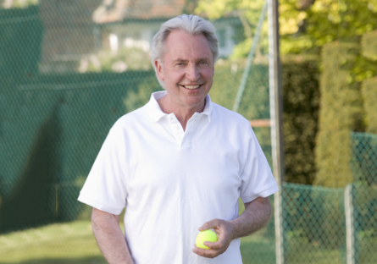
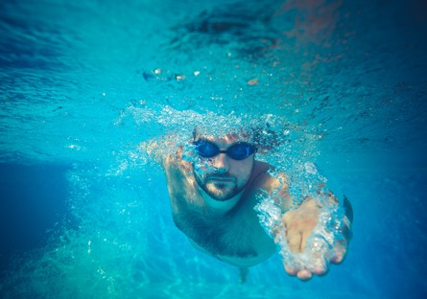

Part 5.0: Wrap-Up
What am I doing?
Notes:
5.1 Guess the Activity (5 min)
Allow three minutes for this slide.
OBJECTIVE
• To review and practice target language from the Unit
INSTRUCTIONS
#1. Have a Student read the question. [What am I doing?]
#2-6. Reveal the images and have the Students ask and answer the question.
ANSWER KEY (Sample Answers)
You’re listening to music.
You’re reading (a book).
You’re playing tennis.
You’re swimming.
You’re cleaning.

Slide 43
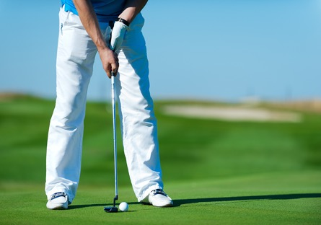




Part 5.0: Wrap-Up
What am I doing?
Notes:
5.1 Guess the Activity
Allow two minutes for this slide.
INSTRUCTIONS
Draw the Students’ attention to the first image and have them ask and answer the question.
#1-4. Reveal the remaining images and have the Students ask and answer the question.
ANSWER KEY (Sample Answers)
You’re playing golf.
You’re singing.
You’re dancing.
You’re at a museum (looking at art).
You’re cooking.

Slide 44

Thank you for coming.
We hope you enjoyed the class.
Don’t forget
to leave feedback!
Teacher
Class was fun
Instructions were clear
«««««
«««««
«««««
«««««
«««««
«««««

Slide 45
© 2017 by Pearson Education Limited All rights reserved.
No part of this publication may be reproduced, stored in a retrieval system, or transmitted in any form or by any means, electronic, mechanical, photocopying, recording or otherwise without the permission of the Publishers.
This material is the intellectual property of Pearson Education Limited.
Image Credits:
Andrey Popov/Fotolia; Sergii Shalimov/Fotolia; eurobanks/Fotolia; JackF/Fotolia; Monkey Business/Fotolia; hitdelight/Fotolia; Monkey Business/Fotolia; Monkey Business/Fotolia; Andrey Burmakin/Fotolia; Monkey Business/Fotolia; Martinan/Fotolia; Sunny studio/Fotolia; Andrey Popov/Fotolia; panomacc/Fotolia; Piotr Marcinski/Fotolia; Igor Mojzes/Fotolia; eurobanks/ Fotolia; Edyta Pawlowska/Fotolia; JackF/Fotolia; hitdelight/Fotolia; Monkey Business/Fotolia; Monkey Business/Fotolia; Monkey Business/Fotolia; Andrey Burmakin/Fotolia; eurobanks/Fotolia; Monkey Business/Fotolia; Sunny studio/Fotolia; panomacc/Fotolia; Monkey Business/Fotolia; Photographee.eu/Fotolia; Riccardo Meloni/Fotolia; Joshua Resnick/Fotolia

